Slide 1
Capstone Project - The Battle of Neighborhoods Report
Kuncoro Aji Nugroho

Slide 2
1. Introduction
In the past decade, the lifestyle of urban people has changed with the trends and habits of drinking coffee. Coffee, which was ancient, is identical to drinks commonly used by older men, now women and men of all ages are accustomed to drinking coffee. And not just enjoying coffee, but many people are looking for a place to drink coffee. The coffee shop has finally become a cool hangout with an internet connection while enjoying a variety of steeping coffee beans. This coffee drinking trend will become a big business opportunity. The business world is starting to work on places that serve specialty coffee.
Although the Indonesian people are not addicted to coffee, which means they have to drink every day, like in Melbourne. And the Coffe shop industry is still relatively new, but in big cities like Jakarta, Coffe shop has the opportunity to get a gross profit of Rp 100 million to Rp 1 billion. However, getting into the business world is not as easy as one might imagine.
If you already have the capital to open a coffee shop, then you must have the courage, start designing strategies and seeing the market. If you have long been in love with coffee and a hobby of drinking coffee, it means you can start a business with the right passion. Therefore I try to practice my learning at Coursera to answer relevant questions, namely designing strategies to determine which areas are suitable for opening coffee shops.

Slide 3
Problem
Finding data about the area and postcode in South Jakarta is a challenge that must be resolved. The price of renting a place to determine the exact location of a coffee shop is also one of the problems that must be resolved.
Interest
I believe this is a relevant challenge with a valid question for anyone who wants to open a coffee shop and determine the right location. The same methodology can be applied according to demands as applicable. This case also applies to anyone interested in exploring starting or finding new business in any city. Finally, this can also serve as a good practical exercise for developing Data Science skills.

Slide 4
2. Data Acquisition and Cleaning
The data acquired for this project is a combination of data from two sources. The first data source of data is scraped from a wikipedia page that contains the list of Neighboorhod East Jakarta ---> https://id.wikipedia.org/wiki/Daftar_kecamatan_dan_kelurahan_di_Kota_Administrasi_Jakarta_Selatan. This page contains additional information about the boroughs, the following are the columns:
Kelurahan : Name of the urban village
Kecamatan : Name of the sub-district
Kota / Provinsi : Name of the province
The Second data source is the list of Logitude & Latitude from website longlat.net, and list of postcode from Wikipedia in East Jakartan, the following are columns:
Kelurahan : Name of the urban village.
PostCode : Number of the posccode area.
Latitude : Latitude of the urban village.
Longitude : Longitude of the urban village.

Slide 5
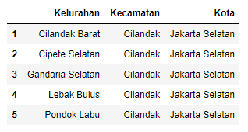
Data Cleaning
The data preparation for each of the two sources of data is done separately. From the East Jakarta data on Wikipedia, The first data is scraped from a wikipedia page using the Beautiful Soup library in python. Using this library we can extract the data in the tabular format as shown in the website. After the web scraping, string manipulation is required to get the10 districts and 65 villages with postal codes 12110 to 12980.

Slide 6
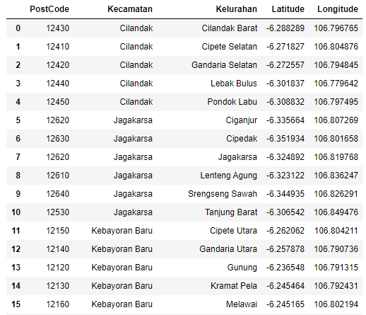
3. Data Cleaning
The Second data source is the list of Logitude & Latitude from website longlat.net, and list of postcode from Wikipedia in East Jakartan.
.

Slide 7
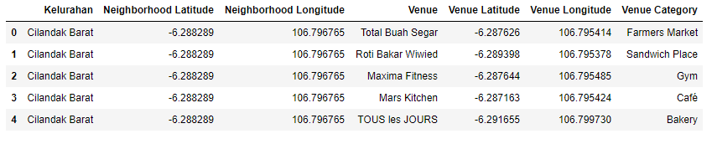
Modelling
Using the final dataset containing the neighborhoods in Kingston upon Thames along with the latitude and longitude, we can find all the venues within a 500 meter radius of each neighborhood by connecting to the Foursquare API. This returns a json file containing all the venues in each neighborhood which is converted to a pandas dataframe. This data frame contains all the venues along with their coordinates and category.
One hot encoding is done on the venues data. (One hot encoding is a process by which categorical variables are converted into a form that could be provided to ML algorithms to do a better job in prediction). The Venues data is then grouped by the Neighborhood and the mean of the venues are calculated, finally the 10 common venues are calculated for each of the neighborhoods. To help people find similar neighborhoods in the safest borough we will be clustering similar neighborhoods using K - means clustering which is a form of unsupervised machine learning algorithm that clusters data based on predefined cluster size. We will use a cluster size of 5 for this project that will cluster the 15 neighborhoods into 5 clusters. The reason to conduct a K- means clustering is to cluster neighborhoods with similar venues together so that people can shortlist the area of their interests based on the venues/amenities around each neighborhood.

Slide 8
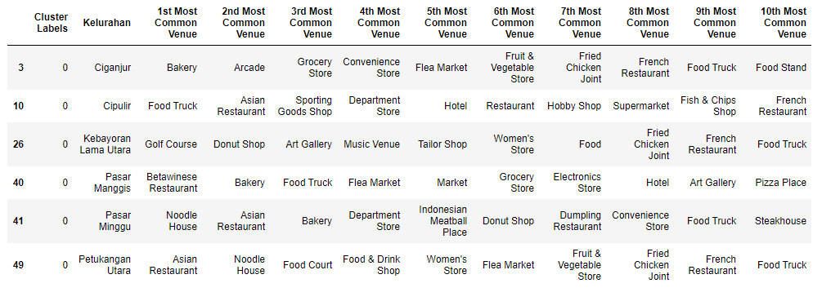
4. Results
After running the K-means clustering we can access each cluster created to see which neighborhoods were assigned to each of the five clusters and drop coffe and caffe venue because we will search best location for open coffe shop . Looking into the neighborhoods in the first cluster.

Slide 9
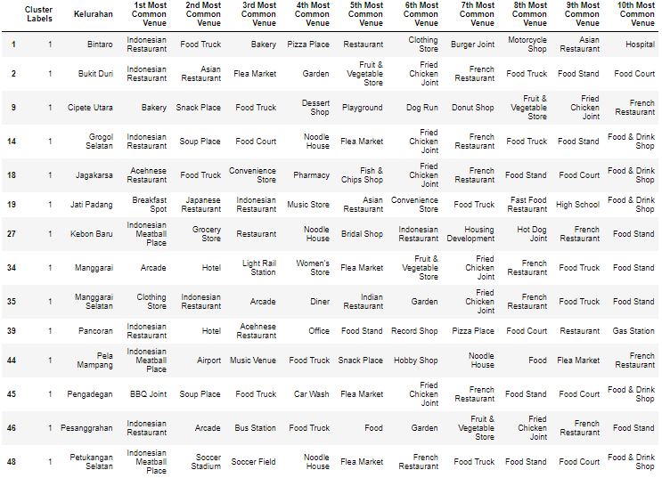
Cluster 2

Slide 10
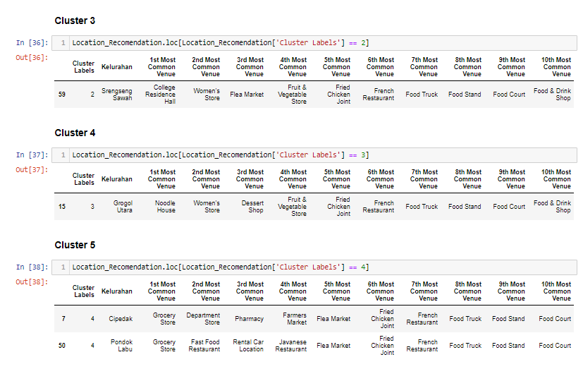
Cluster 3 – 5
Looking into the neighborhoods in the second, third and fifth clusters, we can see these clusters have only one neighborhood in each. This is because of the unique venues in each of the neighborhoods, hence they couldn't be clustered into similar neighborhoods .

Slide 11
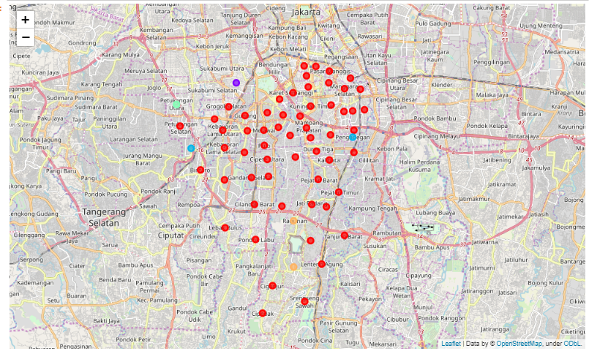
Visualising the clustered neighborhoods on a map using the folium library.

Slide 12
5. Discussion
The purpose of this project is to help people or coffee shop owners who want to open a new shop in an area by comparing the number of coffee shops in the area. The right area to open coffee shops for the first time is in clusters 3, 4 or 5 because the venue categories such as Food Trucks, Food Stands and Food Court indirectly there is a possibility of coffee menus in the venue and still a little even mostly above the 5th Most Common Venue. But if you want to open branches or add franchises to clusters 1 and 2 can be a consideration.

Slide 13
6. Conclusion
This project helps one get a better understanding of the environment in relation to the most suitable place to open coffee shops. The future of this project includes considering other factors such as the cost of renting a place, the price of land to open a new coffee shop or even the work and salaries of each person in the area to be able to more accurately determine the price of coffee to be sold.

